Slide 1
Prototype lab flow
Sukhdeep Sehra

Slide 2
Introduction
PROPOSAL: A project that manages the flow of items entering in and leaving out of the prototype lab
QR Code scanning
Logs items in to the database
Save time by being efficient

Slide 3
budget
Total Cost = $198.85
Item | Make/Model | Description | Status | Quantity | Cost | Final Cost
Raspberry Pi | RPi3 Model B | Required to run the database server. | Acquired [from Starter kit] (www.raspberrypi.org/products/raspberry-pi-3-model-b) | 1
USB Webcam | Microsoft Lifecam HD-3000 | Required to read QR codes. | Purchased (www.amazon.ca/dp/B009VL9YJ2) | 1 | $35.99 | $40.67
Starter Kit | Raspberry Pi Starter Kit | AC Adapter and SD card required. Case is not necessary. | Purchased (www.amazon.ca/dp/B01CCF6V3A) | 1 | $99.99 | $112.98
PCB | Printed Circuit Board | A required a circuit to light up the L.E.D once the webcam scans a QR Code | Acquired (Humber Prototype Lab) | 1 | $40.00 | $45.20

Slide 4
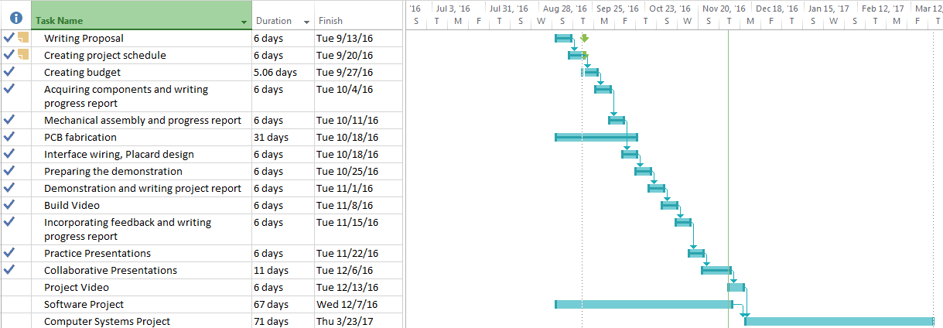
Project Schedule

Slide 5

build VIDEO

Slide 6
Knowledge from previous courses
TECH 101 – Electric Circuits & TECH 150 – AC Circuits Building, designing, and testing circuits.
CENG 215 – Digital and Interfacing Systems Using logic to manipulate circuits.
CENG 216 – Intro to Software Engineering & WRIT 220 Gantt Chart and writing weekly progress reports.
CENG 256 - Unix Internals
Using shell scripting to blink the led.

